Slide 1

SMART INDIA HACKATHON 2026
Problem Statement ID – SIH26190
Problem Statement Title- Secure Digital Document Management System for Legal and Investigation Documents
Theme- Miscellaneous
PS Category- Software
Team ID- SIH26-A0H-T159
Team Name (Registered on portal)- Tech Knights

Slide 2

PROPOSED SOLUTION
TECH
KNIGHTS
SOLUTION :
An encrypted, AI-secured digital document management platform built for legal and investigation records – with tamper-proof verification at its core.
Encrypted document vault with role-, location- & time-bound access
Digital fingerprint auto-verifies every document, flags tampering instantly
AI deepfake & tamper detection for documents, audio and video
Immutable, chain-linked logbook records every view, download, edit and share
Hierarchical access – Officer → MFA → Dept → Role → Clearance → Case
One-click “proof pack” generation, ready for court submission
Problem Resolution :
MFA-based access control eliminates unauthorized viewing across departments and cases. Also access is granted on a limited basis, subject to individual justification.
Continuous verification instantly flags tampering, replacing slow, error-prone manual checks and automatically detects duplicate documents.
Sensitive cases are automatically assigned anonymized codes to maintain confidentiality and certain users are granted temporary, time-bound access.
Chain-linked, unerasable logs guarantee the unbroken chain of custody courts require
Unique Value Propositions (UVP) :
Panic/duress access mode – opens a decoy view and silently alerts authorities
True redaction permanently removes data, not just hides it
Background integrity checks catch tampering even if a file sits untouched for weeks
AI-generated case timeline auto-built from events across uploaded documents
Reputation-weighted access for smoother, safer multi-agency case sharing

Slide 3

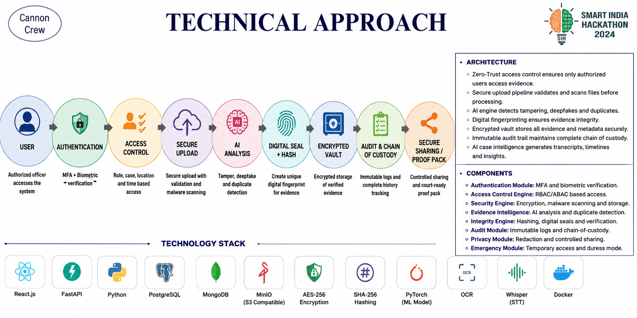
TECHNICAL APPROACH
TECH
KNIGHTS
ARCHITECTURE
○ Zero-Trust access control verifies identity, role, clearance, case, location and time before granting access.
○ Secure upload pipeline validates files, scans malware and checks authenticity before storage.
○ AI-based evidence analysis detects tampering, deepfakes, duplicates and suspicious content.
○ Digital fingerprinting generates SHA-256/perceptual hashes to identify and verify evidence.
○ Encrypted evidence vault securely stores documents, media, transcripts and metadata.
○ Continuous integrity monitoring periodically verifies stored evidence against its original fingerprint.
○ Immutable chain of custody records every access, modification, download and sharing activity.
○ AI case intelligence generates transcripts, timelines and detects inconsistencies.
COMPONENTS
○ Authentication Module: MFA and biometric verification.
○ Access Control Engine: RBAC/ABAC-based permissions.
○ Security Engine: Encryption, malware scanning and secure storage.
○ Evidence Intelligence: AI tamper, deepfake and duplicate detection.
○ Integrity Engine: Hashing, digital seals and continuous verification.
○ Audit Module: Immutable logs and chain-of-custody tracking.
○ Privacy Module: Redaction and controlled document sharing.
○ Emergency Module: Temporary access, duress mode and dual authorization.
TECHNOLOGICAL STACK

Slide 4

TECH
FEASIBILITY AND VIABILITY
KNIGHTS
Technical Feasibility
Economical Feasibility
Maintenance & Safety Feasibility
Role-based encrypted access – MFA + officer→dept→role→case hierarchy (OAuth2/TOTP).
AES-256/RSA + SHA-256 fingerprinting – open-source; flags tampering instantly.
AI deepfake/tamper detection – open-source models, self-hosted (no per-scan fee).
Immutable hash-chained logbook – tamper-evident chain-of-custody, no blockchain overhead.
Perceptual-hash duplicate detection – auto-links duplicate/near-duplicate evidence.
AI auto-redaction & timeline-builder – redacts sensitive fields, extracts case events.
Evaluation Parameter | Manual / Legacy Records | Proposed Smart System
Setup Cost | Low, paper-based | ₹0–1k (pilot; free-tier + OSS)
Manpower Required | 4–5 records clerks | 1 admin + automation
Verification Time | 2–3 days manual cross-check | Real-time (seconds)
Tamper Detection | Manual, error-prone | Automated hash re-check
Storage & Retrieval | Physical, slow, degradable | Encrypted, instant search
Operational Cost Cut | — | ≈ 50–60%
Background integrity checks – hashes are quietly re-verified on a timer, not only on access.
Malware & tamper scanning runs at repeated intervals automatically in the background.
Panic / duress access mode opens a decoy view and silently alerts authorities under threat.
Two-person deletion rule – no single user can permanently erase evidence alone.
Estimated Cost & Resources
Implementation Viability
Environmental Viability
Built by the team on the open-source stack – ₹0 development cost, no hired team.
Hosting on free-tier cloud (AWS/Azure/GCP Student, Oracle Always Free) – ₹0 for pilot.
Domain name (.in) – ≈ ₹700/yr – the only real recurring expense.
SSL certificate – free, via Let's Encrypt.
AI models run on free Colab/Kaggle GPU credits – ₹0 during pilot.
Pilot cost: under ₹1,000 total (your own team, free-tier cloud, open-source stack).
If the state develops & deploys it: reuse NIC cloud/CCTNS infra + empanelled devs (~3–4 months) ≈ ₹5–8 Lakh one-time, ≈ ₹1–2 Lakh/yr upkeep – cheapest route since it's built on infra govt already owns, not fresh servers/vendors.
Factor | Support Element
Technology Stack | Standard AES/RSA encryption, SHA-256 hashing, MFA – widely available, low-cost.
Component Integration | Modular APIs – access hierarchy, audit log, deepfake scan plug in independently.
Deployment Readiness | Prototype ready for field testing; cloud deployment, no niche hardware.
Scalability | Modular add-ons – duress mode, timeline builder, reputation scoring.
Serviceability | Automated hourly integrity re-checks reduce manual upkeep.
Fully paperless case files eliminate printing, physical filing and evidence-room storage needs.
Cuts physical transport of documents between stations, courts and forensic labs.
Supports Digital India and e-governance goals through secure digitisation.
Reduces long-term archival footprint – no warehousing of degrading paper records.

Slide 5

IMPACT AND BENEFITS
Potential Impact on the Target Audience
Investigators, prosecutors and courts get faster, verifiable access to case files, cutting delays caused by manual filing and lost records
A single, auditable source of truth for case records reduces procedural errors and disputes over documentation
Citizens benefit from faster case resolution and greater confidence that evidence has not been tampered with
Agencies gain role-based, encrypted access with full audit trails, protecting chain-of-custody integrity
Benefits of the Solution
Social
Builds public trust through tamper-proof records and improves access to justice
Economic
Cuts storage and retrieval costs, and reduces case backlogs and admin man-hours
Environmental
Reduces paper usage and physical archive space, supporting paperless legal infrastructure
Security & Governance
Role-based access and audit trails prevent tampering, protecting chain-of-custody integrity

Slide 6
RESEARCH AND REFERENCES
Government & Policy
Information Technology Act, 2000 - Ministry of Electronics & IT, Government of India
Indian Evidence Act, 1872 - Section 65B, Admissibility of Electronic Records
Crime & Criminal Tracking Network & Systems (CCTNS) / ICJS - Ministry of Home Affairs, GoI
e-Courts Mission Mode Project, Phase III (2023-2027) - Department of Justice, GoI
Cryptography & Security Standards
NIST FIPS 197 - Advanced Encryption Standard (AES)
NIST FIPS 180-4 - Secure Hash Standard (SHA-256)
Excavating Vulnerabilities in Multi-Factor Authentication Protocols (arXiv, 2024)
AI Tamper & Deepfake Detection
A Survey of Deepfake Detection Methods - IEEE, 2023
The Societal Impact of Deepfakes: Advances in Detection and Mitigation - IEEE, 2023
Digital Forensics & Chain of Custody
Blockchain-Enhanced Chain of Custody for Digital Forensic Evidence Management - IEEE, 2025
B-CoC: A Blockchain-based Chain of Custody for Evidence Management in Digital Forensics (arXiv)
Access Control & Identity Management
Role-Based Access Control (RBAC) in Modern Cloud Security Governance - IJSRCSEIT, 2025
ABAC vs RBAC: Access Control Models for Zero-Trust Architectures - Security Literature Review

